Slide 1
Programming Fundamentals in C++
(Practical#03)

Slide 2
Object : To become familiar with Operators in C++
Operators : Are the symbols that perform operations / calculations on operands.
Three categories of operators :
Binary Operators : act or operate on two operands.
Unary Operators act or operate on one operand
Ternary Operators act or operate on three operands

Slide 3
Expression : any arrangement of variables,
constants and operators that specifies a computation.
Example :
sum = num1+num2;
Expression
Variable
Assignment Operator
Variable
Arithmetic Operator
Variable

Slide 4
Three categories of operators
Binary Operators : act or operate on two operands.
Unary Operators : act or operate on one operand.
Ternary Operators : act or operate on three operands.

Slide 5
Three categories of operators : (Binary, Unary, Ternary)
Binary Operators : act or operate on two operands.
Arithmetic Operators
Operators | Result
+ | Addition
__ | Subtraction
* | Multiplication
/ | Division
% | Remainder or Modulus

Slide 6
Arithmetic Operator Example
#include<iostream>
using namespace std;
int main() {
int a = 4, b = 2, c;
c = a + b;
cout<<"Addition: "<<c;
c=a-b;
cout<<"\nSubtraction: "<<c;
c = a * b;
cout<<"\nMultiplication: "<<c;
c = a / b;
cout<<"\nDivision:"<<c;
c = a % b;
cout<<"\nModulus: "<<c;
}

Slide 7
Arithmetic Assignment Operators
C++ provides several assignment operators for abbreviating assignment expressions.
For example, you can abbreviate the statement
c = c + 3;
with the addition assignment operator, +=, as
c += 3;

Slide 8
Compound Assignment Operators
Operator | Example Expression | Result
+= | var1+=var2 | var1 is assigned the value that is the sum of var1 and var2
_= | var1-=var2 | var1 is assigned the value that is the value of var2 subtracted from the value of var1
*= | var1*=var2
/=
%=

Slide 9
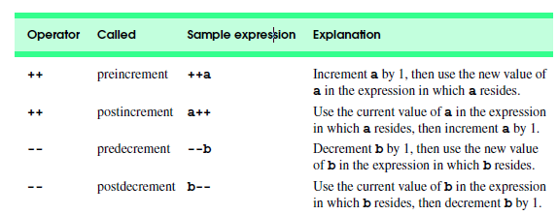
Unary Operators act or operate on one operand
Increment & Decrement Operators : C++ provides two unary operators for adding 1 to or subtracting 1 from the value of a numeric variable.

Slide 10
Increment & Decrement Operators
Operator | Example Expression | Result
++ | var1=++var2 | var1 is assigned the value of var2+1.
++ | var1=var2++ | var1 is assigned the value of var2. var2 is incremented by 1.
-- | var1= --var2
-- | var1=var2--

Slide 11
Pre-incrementing and post-incrementing Example
// main method begins execution of C++ program
#include<iostream>
using namespace std;
int main() {
int c;
c = 5;
cout<<c<<endl; // print 5
cout<<c++<<endl;
cout<<c<<endl;
c = 5;
cout<<c<<endl;
cout<< ++c<<endl;
cout<<c;
}

Slide 12
Operator Precedence and associativity
The order in which operators are evaluated
The operator precedence determines which operator is to be first evaluated
The other term which is related to expression is operator associativity. Operator associativity determines the direction of operator evaluation of the same operator precedence, associativity can be left to right or right to left.
So, Operators Precedence and operator Associativity are two characteristics of operators that specify the order of evaluation in an expression.

Slide 13
Operator Precedence and associativity
Example 4 + 2 * 3 =
example: x = 10 + 22 / 2.
In the above example, the result is 21, not 16 because the
‘/’ operator has higher precedence than the ‘+’ operator.

Slide 14
Operator Precedence and associativity
an example: x = 10 -20+ 22 / 2.
In the above example, the result is 1, not 19 because the same as above ‘/’ operator has higher precedence than the ‘+’ operator and ‘+’ and ‘-‘ operator is of the same precedence and their associativity is left to right so the expression evaluates as –
x = 10 – 20+ 22 / 2
x=10 – 20+11
x=-10+11
x=1

Slide 15
Operators Associativity is used when two operators of same precedence appear in an expression. Associativity can be either Left to Right or Right to Left.
For example: ‘*’ and ‘/’ have same precedence and their associativity is Left to Right, so the
expression “100 / 10 * 10” is treated as “(100 / 10) * 10”.
Example
100+20/10 -30 *10;=
Example
int x=7, y=2;
int result= ++x + --y;

Slide 16
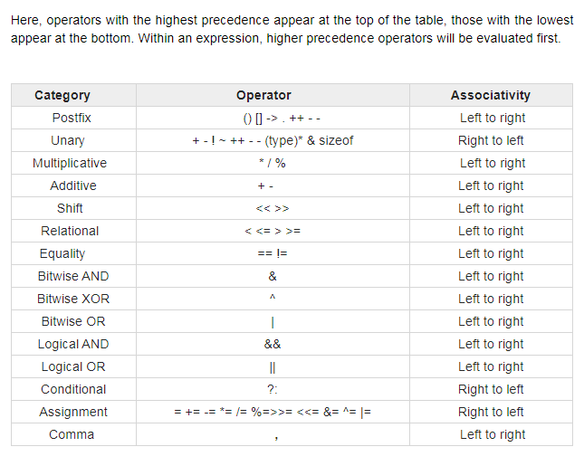

Slide 17
Relational Operators
C++ has six relational operators that compare two variables or numbers and return a Boolean value. i.e true(1) or false(0)
The outcome of these operators is a Boolean value.
Boolean Expression : which involves a relational operator and returns a Boolean value ie. either true(1) or false (0)
Operator Meaning
== Equal to
> Greater than
>= Greater than or equal to
< Less than
<= Less than or equal to
!= not equal to

Slide 18
Relational Operators
Operator | Example Expression | Result
== | var1=var2==var3; | var1 is assigned the value true(1) if var2 is equal to var3, or false (0)otherwise.
!= | var1= var2 !=var3; | var1 is assigned the value true(1) if var2 is not equal to var3, or false (0) otherwise.
< | Var1= var2 < var3;
<= | Var1=var2<=var3;
> | Var1=var2 > var3;
>= | Var1=var2>=var3;

Slide 19
Relational Operators Example
int a = 10; int b = 20;
cout<< "a == b = " << (a == b)<<endl;
cout<< "a != b = " << (a != b)<<endl;
cout<< "a > b = " << (a > b)<<endl;
cout<< "a < b = " << (a < b)<<endl;
cout<< "b >= a = " << (b >= a)<<endl;
cout<< "b <= a = " <<(b <= a)<<endl;
output

Slide 20
The Logical Operators
Are used to combine two or more Boolean expression.
C++ provides logical operators to enable programmers to form more complex conditions by combining simple conditions. The logical operators are
&& ( AND),
|| (logical OR),
! (logical NOT, also called logical negation).

Slide 21
The Logical Operators
#include<iostream>
using namespace std;
int main() {
int a = 20; int b = 20;
cout<< "output=" << (a > 10|| a< 20)<<endl;
}

Slide 22
The Bitwise Operators
There are also the bitwise operators in c++ which are used to perform bitwise operations on bit patterns or binary numerals that involve the manipulation of individual bits.
Bitwise operators can be applied to the integer types, long, int, short, char, and byte.
Bitwise operator works on bits and performs bit-by-bit operation.
Example if a = 60 and b = 13; now in binary format they will be as follows −
a = 0011 1100
b = 0000 1101

Slide 23
Operator | Description
& (bitwise and) | Binary AND Operator
| (bitwise or) | Binary OR Operator
^ (bitwise XOR) | Binary XOR Operator
~ (bitwise compliment) | Binary Ones Complement Operator is unary and has the effect of 'flipping' bits.
<< (left shift) | Binary Left Shift Operator. The left operands value is moved left by the number of bits specified by the right operand.
>> (right shift) | Binary Right Shift Operator. The left operands value is moved right
& = | Binary AND assignment Operator
|= | Binary OR assignment Operator
^= | Binary XOR assignment Operator
<<= | Binary Left Shift assignment Operator.
>> = | Binary Right Shift assignment Operator.

Slide 24
The Bitwise Operators
The Bitwise NOT
Example Number 42 in binary is 00101010
After Bitwise NOT operation the value is 11010101
The Bitwise AND

Slide 25
The Bitwise Operators
The Bitwise OR
The Bitwise XOR

Slide 26
The Bitwise Operators
Binary Left Shift Operator. The left operands value is moved left by the number of bits specified by the right operand.
value << num
Example
13<<2 = 52
13 in binary is 00000000000000000000000000001101
shift left 2 positions and fill right bits with 0,s
you obtain : 00000000000000000000000000110100

Slide 27
The Bitwise Operators
cout<<"<< Operator"<<endl;
// shift all the bits to the left by 2
int y = 13<<2;
cout<<"13<<2 = "<<y<<endl;

Slide 28
The Bitwise Operators
The Right Shift : The left operands value is moved right by the number of bits specified by the right operand.
value >> num
Explanation of 20>>2 = 5
20 in binary is: 00000000000000000000000000010100
shift all bits 2 positions to right 00000000000000000000000000000101

Slide 29
Input with cin>>
cin is a predefined object in c++. Corresponds to the standard input stream.
U can take input from the user at run-time.
U can obtain input from the user while your program is running.
Cin in is in conjunction with the >> extraction operator
>> is extraction or get from operator it takes value on its left and places it in the variable on its right

Slide 30
Casting
The casting applies to data conversions specified by the programmer.
Casting also called type casts or Type Conversion.
Two Types of Casting Implicit and Explicit
Implicit conversions: do not require any code from the programmer . They are automatically performed by the complier
Example char c=‘A’;
int a=c; // implicit casting

